Slide 1
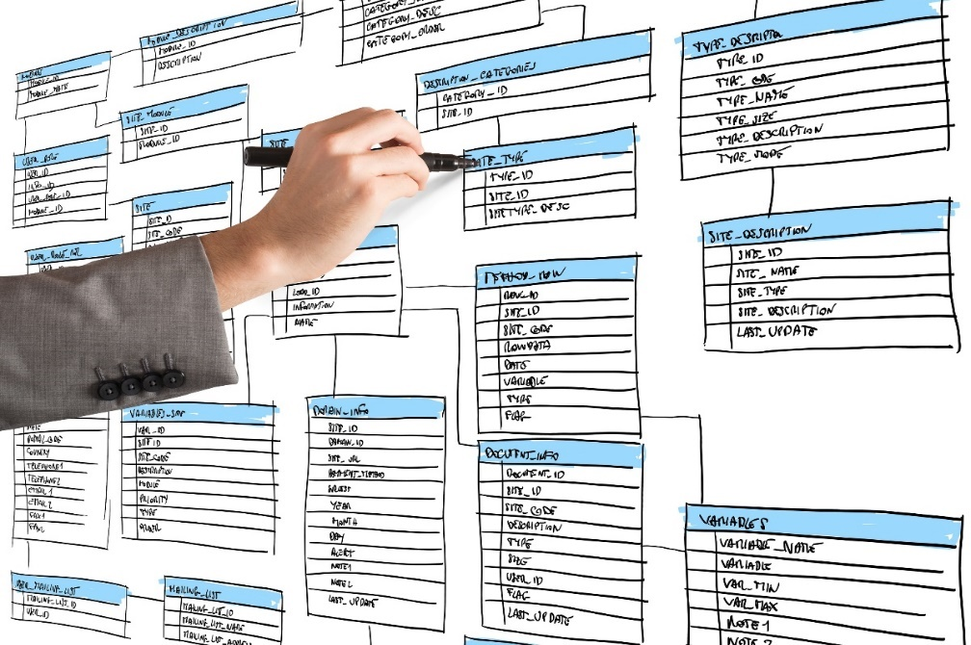
Relational Databases
Tables
Constraints
Relationships
Select
Join

Slide 2

See Also
http://www.tutorialspoint.com/sql/sql-overview.htm
https://en.wikipedia.org/wiki/Relational_database
Notes:
Some additional information on concurrency

Slide 3
Tables
public class Book
public Book[] books;
column
BOOK
String ISBN = “1234”
String name = “Learn C++”
Double price = 9.95
String publisher = “Good Books”
String
String
Double
String
String ISBN = “5678”
String name = “Learn Java
Double price = 50.00
String publisher = “Smarties”
ISBN
Name
Price
Publisher
1234
Learn C++
9.95
Good Books
String ISBN = “9981”
String name = “Using Perl”
Double price = 2.46
String publisher = “Smarties”
5678
Learn Java
50.00
Smarties
String ISBN = “1055”
String name = “JavaScript”
Double price = 10.00
String publisher = “Good Books”
row
9981
Using Perl
2.46
Smarties
1055
JavaScript
10.00
Good Books
Streams of bytes … two ways (into your program and out of your program)
Disks, consoles, sockets, keyboards, printers
Know how to talk streams and you can talk to anything
Initialization (constructor) is different. Use is the same.

Slide 4
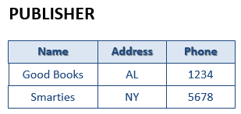
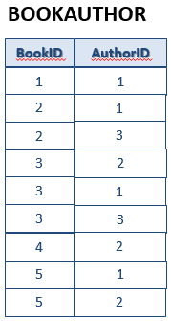

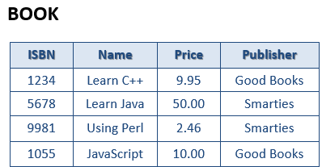

Talking to a Database
Schema: APP
> Connect to database
> Create table Publisher ...
> Get rows from Book ...
Schema: HR
> Update rows in Author ...
> Delete rows in Book ...
> Close connection
Streams of bytes … two ways (into your program and out of your program)
Disks, consoles, sockets, keyboards, printers
Know how to talk streams and you can talk to anything
Initialization (constructor) is different. Use is the same.

Slide 5

Constraints (Rules)
BOOK
ISBN
Name
Price
Publisher
> addRow("1055","JavaScript",10.00,"Good Books")
OK
> addRow("5678","COBOL",10.00,"Good Books")
NO! "5678" is not unique
1234
Learn C++
9.95
Good Books
5678
Learn Java
50.00
Smarties
9981
Using Perl
2.46
Smarties
1055
JavaScript
10.00
Good Books
5678
COBOL
50.00
Good Books
Must be unique
Greater or equal zero
Streams of bytes … two ways (into your program and out of your program)
Disks, consoles, sockets, keyboards, printers
Know how to talk streams and you can talk to anything
Initialization (constructor) is different. Use is the same.

Slide 6
Relationships
BOOK
ISBN
Name
Price
Publisher
Address
Phone
Author
Address
Phone
1234
Learn C++
9.95
Good Books
AL
1234
Ben
CA
1111
5678
Learn Java
50.00
Smarties
NY
5678
Ben
CA
1111
9981
Using Perl
2.46
Smarties
NY
5678
Sarah
TX
5555
1055
JavaScript
10.00
Good Books
AL
1234
Sarah
TX
5555
5679
COBOL
50.00
Good Books
AL
1234
Ben
CA
1111
PUBLISHER
AUTHOR
Name
Address
Phone
Name
Address
Phone
Good Books
AL
1234
Ben
CA
1111
Smarties
NY
5678
Sarah
TX
5555
Streams of bytes … two ways (into your program and out of your program)
Disks, consoles, sockets, keyboards, printers
Know how to talk streams and you can talk to anything
Initialization (constructor) is different. Use is the same.

Slide 7
Primary and Foreign Keys
BOOK
ISBN
Name
Price
Publisher
Author
1234
Learn C++
9.95
Good Books
Ben
5678
Learn Java
50.00
Smarties
Ben
The column is a FOREIGN KEY. It references another table.
9981
Using Perl
2.46
Smarties
Sarah
1055
JavaScript
10.00
Good Books
Sarah
5679
COBOL
50.00
Good Books
Ben
The column is a PRIMARY KEY. Other tables may reference it.
PUBLISHER
AUTHOR
Name
Address
Phone
Name
Address
Phone
Good Books
AL
1234
Ben
CA
1111
Smarties
NY
5678
Sarah
TX
5555
Streams of bytes … two ways (into your program and out of your program)
Disks, consoles, sockets, keyboards, printers
Know how to talk streams and you can talk to anything
Initialization (constructor) is different. Use is the same.

Slide 8
Primary and Foreign Keys
BOOK
ISBN
Name
Price
Publisher
Author
> create book ("7","Ada",1.00,"Smarties","Joe")
I can’t. "Joe" is not valid.
> delete author "Ben"
I can’t. Row is being referenced.
1234
Learn C++
9.95
Good Books
Ben
5678
Learn Java
50.00
Smarties
Ben
9981
Using Perl
2.46
Smarties
Sarah
1055
JavaScript
10.00
Good Books
Sarah
5679
COBOL
50.00
Good Books
Ben
PUBLISHER
AUTHOR
Name
Address
Phone
Name
Address
Phone
Good Books
AL
1234
Ben
CA
1111
Smarties
NY
5678
Sarah
TX
5555
Streams of bytes … two ways (into your program and out of your program)
Disks, consoles, sockets, keyboards, printers
Know how to talk streams and you can talk to anything
Initialization (constructor) is different. Use is the same.

Slide 9
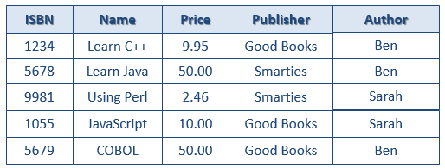
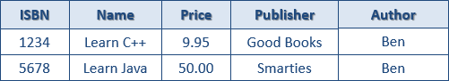
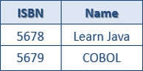
Select, Where, Order By
BOOK
ISBN
Name
Price
Publisher
Author
1234
Learn C++
9.95
Good Books
Ben
5678
Learn Java
50.00
Smarties
Ben
9981
Using Perl
2.46
Smarties
Sarah
1055
JavaScript
10.00
Good Books
Sarah
5679
COBOL
50.00
Good Books
Ben
> Get all rows from BOOK
Here are 5 rows.
> Select * from BOOK where Author = 'Ben'
Here are 3 rows.
> Select ISBN, Name from BOOK where Author = 'Ben' and Price >= 10.0
Here are 2 rows.
Streams of bytes … two ways (into your program and out of your program)
Disks, consoles, sockets, keyboards, printers
Know how to talk streams and you can talk to anything
Initialization (constructor) is different. Use is the same.

Slide 10
Select, Where, Order By
BOOK
ISBN
Name
Price
Publisher
Author
1234
Learn C++
9.95
Good Books
Ben
5678
Learn Java
50.00
Smarties
Ben
9981
Using Perl
2.46
Smarties
Sarah
1055
JavaScript
10.00
Good Books
Sarah
5679
COBOL
50.00
Good Books
Ben
> Select * from BOOK where Author = "Ben" order by Price desc
Here are 3 rows.
Streams of bytes … two ways (into your program and out of your program)
Disks, consoles, sockets, keyboards, printers
Know how to talk streams and you can talk to anything
Initialization (constructor) is different. Use is the same.

Slide 11
Joins
BOOK
PUBLISHER
ISBN
Name
Price
Publisher
Author
Name
Address
Phone
1234
Learn C++
9.95
Good Books
Ben
Good Books
AL
1234
5678
Learn Java
50.00
Smarties
Ben
Smarties
NY
5678
9981
Using Perl
2.46
Smarties
Sarah
> Select * from BOOK, PUBLISHER
Here are 8 rows.
1055
JavaScript
10.00
Good Books
Sarah
ISBN
Name
Price
Publisher
Author
Name
Address
Phone
1234
Learn C++
9.95
Good Books
Ben
Good Books
AL
1234
5678
Learn Java
50.00
Smarties
Ben
Good Books
AL
1234
9981
Using Perl
2.46
Smarties
Sarah
Good Books
AL
1234
1055
JavaScript
10.00
Good Books
Sarah
Good Books
AL
1234
1234
Learn C++
9.95
Good Books
Ben
Smarties
NY
5678
5678
Learn Java
50.00
Smarties
Ben
Smarties
NY
5678
9981
Using Perl
2.46
Smarties
Sarah
Smarties
NY
5678
1055
JavaScript
10.00
Good Books
Sarah
Smarties
NY
5678
Streams of bytes … two ways (into your program and out of your program)
Disks, consoles, sockets, keyboards, printers
Know how to talk streams and you can talk to anything
Initialization (constructor) is different. Use is the same.

Slide 12
Joins
BOOK
PUBLISHER
Name
Address
Phone
ISBN
Name
Price
Publisher
Author
Good Books
AL
1234
1234
Learn C++
9.95
Good Books
Ben
Smarties
NY
5678
5678
Learn Java
50.00
Smarties
Ben
9981
Using Perl
2.46
Smarties
Sarah
> Select * from BOOK, PUBLISHER where BOOK.publisher = PUBLISHER.name
Here are 4 rows.
1055
JavaScript
10.00
Good Books
Sarah
ISBN
Name
Price
Publisher
Author
Name
Address
Phone
1234
Learn C++
9.95
Good Books
Ben
Good Books
AL
1234
5678
Learn Java
50.00
Smarties
Ben
Good Books
AL
1234
9981
Using Perl
2.46
Smarties
Sarah
Good Books
AL
1234
1055
JavaScript
10.00
Good Books
Sarah
Good Books
AL
1234
1234
Learn C++
9.95
Good Books
Ben
Smarties
NY
5678
5678
Learn Java
50.00
Smarties
Ben
Smarties
NY
5678
9981
Using Perl
2.46
Smarties
Sarah
Smarties
NY
5678
1055
JavaScript
10.00
Good Books
Sarah
Smarties
NY
5678
Streams of bytes … two ways (into your program and out of your program)
Disks, consoles, sockets, keyboards, printers
Know how to talk streams and you can talk to anything
Initialization (constructor) is different. Use is the same.

Slide 13
Why Join?
PUBLISHER
BOOK
ISBN
Name
Price
Publisher
Author
Name
Address
Phone
1234
Learn C++
9.95
Good Books
Ben
Good Books
AL
1234
5678
Learn Java
50.00
Smarties
Ben
Smarties
NY
5678
9981
Using Perl
2.46
Smarties
Sarah
1055
JavaScript
10.00
Good Books
Sarah
> Select ISBN, BOOK.name, Price, Author, PUBLISHER.name, address, phone from BOOK, PUBLISHER where BOOK.publisher = PUBLISHER.name
Here are 4 rows.
ISBN
Name
Price
Author
Name
Address
Phone
1234
Learn C++
9.95
Ben
Good Books
AL
1234
1055
JavaScript
10.00
Sarah
Good Books
AL
1234
5678
Learn Java
50.00
Ben
Smarties
NY
5678
9981
Using Perl
2.46
Sarah
Smarties
NY
5678
Streams of bytes … two ways (into your program and out of your program)
Disks, consoles, sockets, keyboards, printers
Know how to talk streams and you can talk to anything
Initialization (constructor) is different. Use is the same.

Slide 14
One to Many
BOOK
BOOKAUTHOR
ISBN
Name
Price
Publisher
Author
ISBN
Author
1234
Learn C++
9.95
Good Books
Ben
1234
Ben
5678
Learn Java
50.00
Smarties
Ben, Pat
5678
Ben
9981
Using Perl
2.46
Smarties
Sarah, Ben, Pat
5678
Pat
1055
JavaScript
10.00
Good Books
Sarah
9981
Sarah
5679
COBOL
50.00
Good Books
Ben, Sarah
9981
Ben
9981
Pat
AUTHOR
1055
Sarah
PUBLISHER
5679
Ben
Name
Address
Phone
5679
Sarah
Name
Address
Phone
Ben
CA
1111
Good Books
AL
1234
Sarah
TX
5555
Smarties
NY
5678
Pat
CO
5309
Streams of bytes … two ways (into your program and out of your program)
Disks, consoles, sockets, keyboards, printers
Know how to talk streams and you can talk to anything
Initialization (constructor) is different. Use is the same.

Slide 15
Separate Primary Key
BOOK
BOOKAUTHOR
ID
ISBN
Name
Price
Publisher
ISBN
Author
1
1234
Learn C++
9.95
Good Books
1234
Ben
2
5678
Learn Java
50.00
Smarties
5678
Ben
3
9981
Using Perl
2.46
Smarties
5678
Pat
4
1055
JavaScript
10.00
Good Books
9981
Sarah
5
5679
COBOL
50.00
Good Books
9981
Ben
9981
Pat
AUTHOR
1055
Sarah
PUBLISHER
5679
Ben
ID
Name
Address
Phone
5679
Sarah
ID
Name
Address
Phone
1
Ben
CA
1111
1
Good Books
AL
1234
2
Sarah
TX
5555
2
Smarties
NY
5678
3
Pat
CO
5309
Streams of bytes … two ways (into your program and out of your program)
Disks, consoles, sockets, keyboards, printers
Know how to talk streams and you can talk to anything
Initialization (constructor) is different. Use is the same.

Slide 16
Separate Primary Key
BOOK
BOOKAUTHOR
ID
ISBN
Name
Price
Publisher
BookID
AuthorID
1
1234
Learn C++
9.95
1
1
1
2
5678
Learn Java
50.00
2
2
1
3
9981
Using Perl
2.46
2
2
3
4
1055
JavaScript
10.00
1
3
2
5
5679
COBOL
50.00
1
3
1
3
3
4
2
AUTHOR
PUBLISHER
5
1
ID
Name
Address
Phone
5
2
ID
Name
Address
Phone
1
Ben
CA
1111
1
Good Books
AL
1234
2
Sarah
TX
5555
2
Smarties
NY
5678
3
Pat
CO
5309
Streams of bytes … two ways (into your program and out of your program)
Disks, consoles, sockets, keyboards, printers
Know how to talk streams and you can talk to anything
Initialization (constructor) is different. Use is the same.

Slide 17

Tinkering
Sketch out the CUSTOMER table. You should track a customer’s address, purchases, and a list of favorite authors (from AUTHOR table).
Sketch the database tables and relationships for a temperature sensor network. There are multiple houses each with multiple rooms each with a temperature sensor. Only keep the current value. How could you handle historic data?
Notes:
Here are some things to think about … nothing to submit.
Share your thoughts in the online portal discussion area.

